Slide 1
Interactive data analysis and visualisation: an introduction to R Shiny apps
PART 2 - REACTIVITY

Slide 2
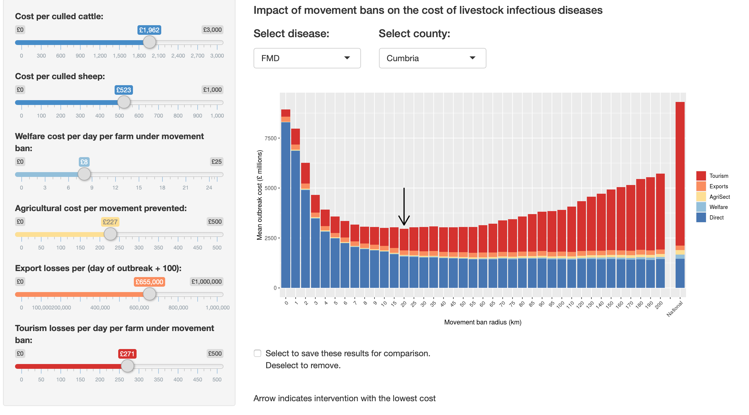
Example app
https://livestockmovements.shinyapps.io/movement_control/
Notes:
App working through

Slide 3
Reactivity in shiny
In Shiny when an input changes, all the related outputs are automatically updated
This is different to standard R code
Execution of code does not happen from the top to the bottom of a script
Instead, in Shiny, code is only run when needed

Slide 4
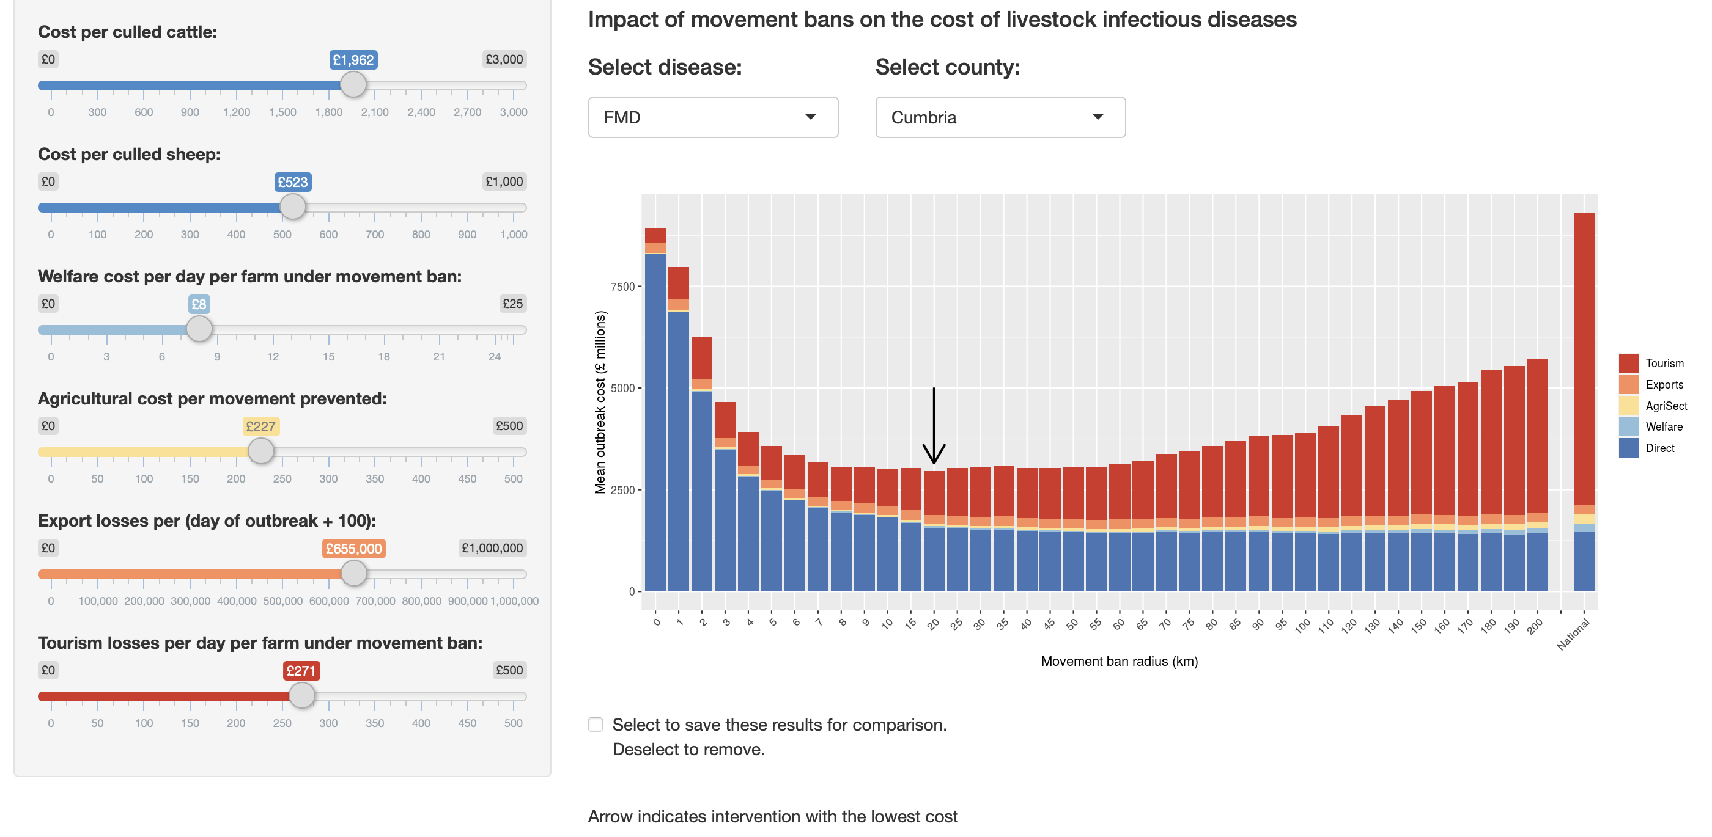

Slide 5
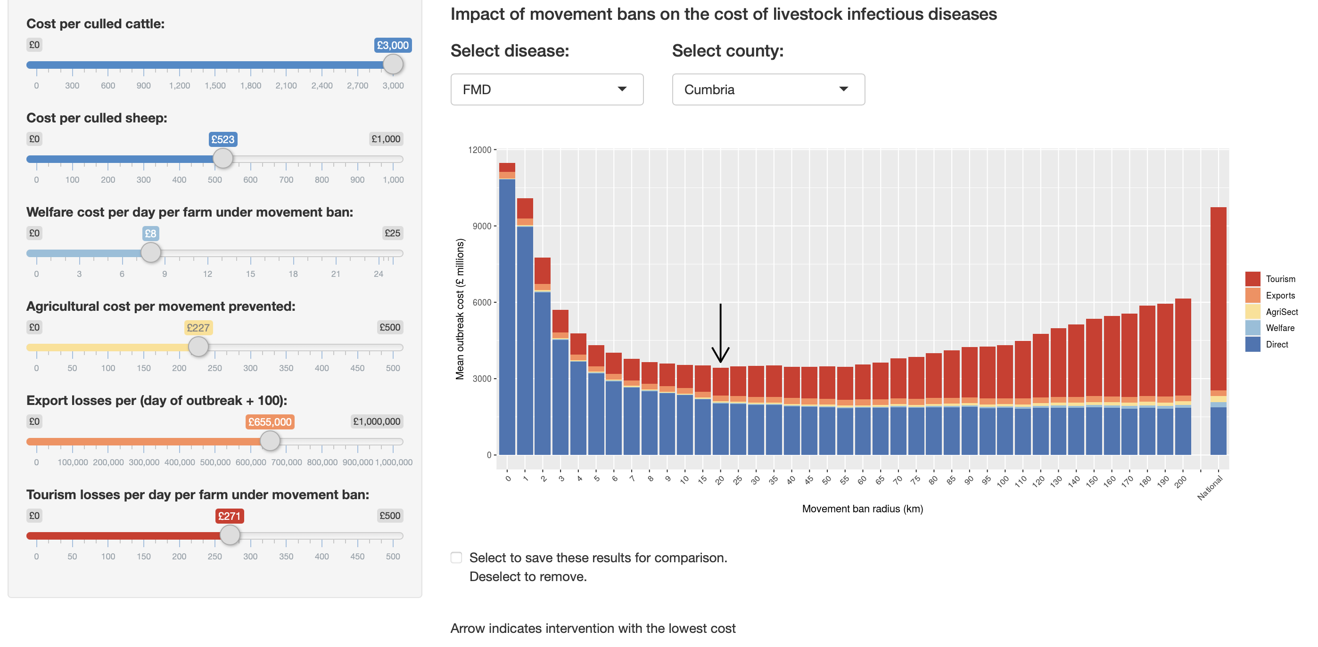

Slide 6
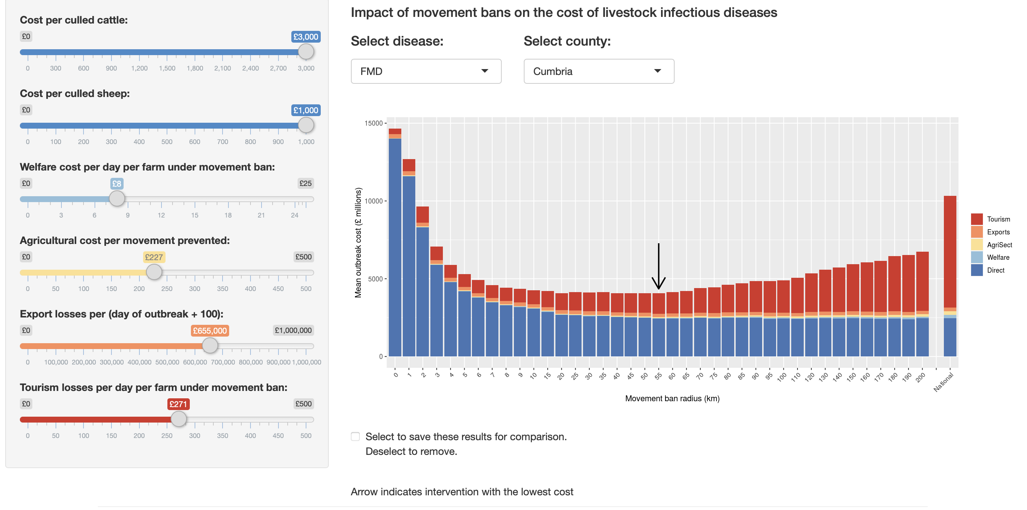

Slide 7
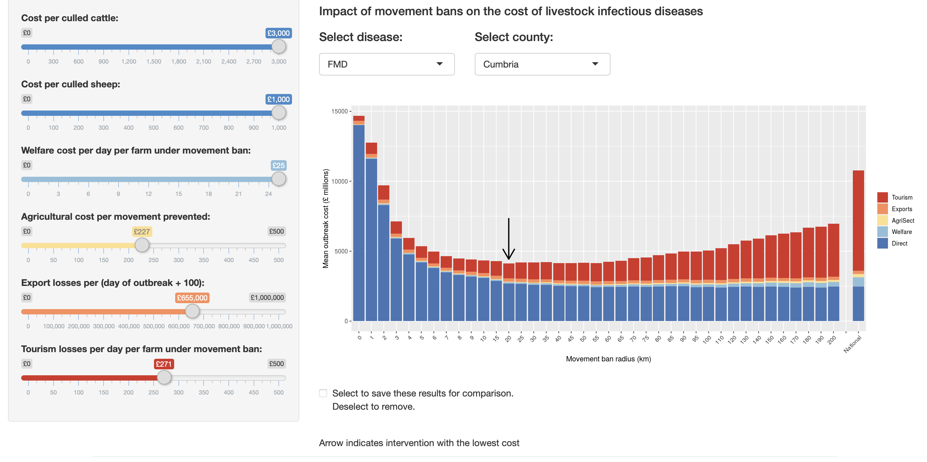

Slide 8
Cattle slider
Sheep slider
Recalculate mean costs
->
Update plot output
Welfare slider
Agricultural slider
Export slider
Tourism slider

Slide 9
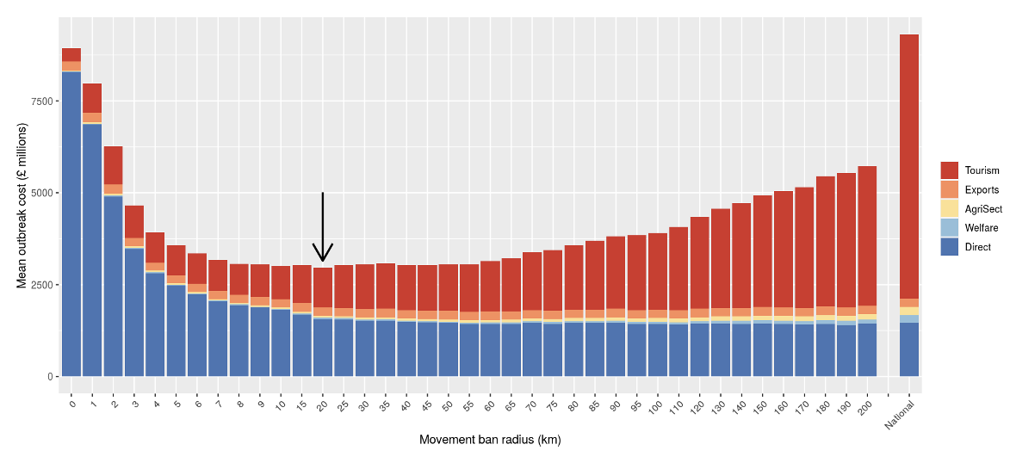
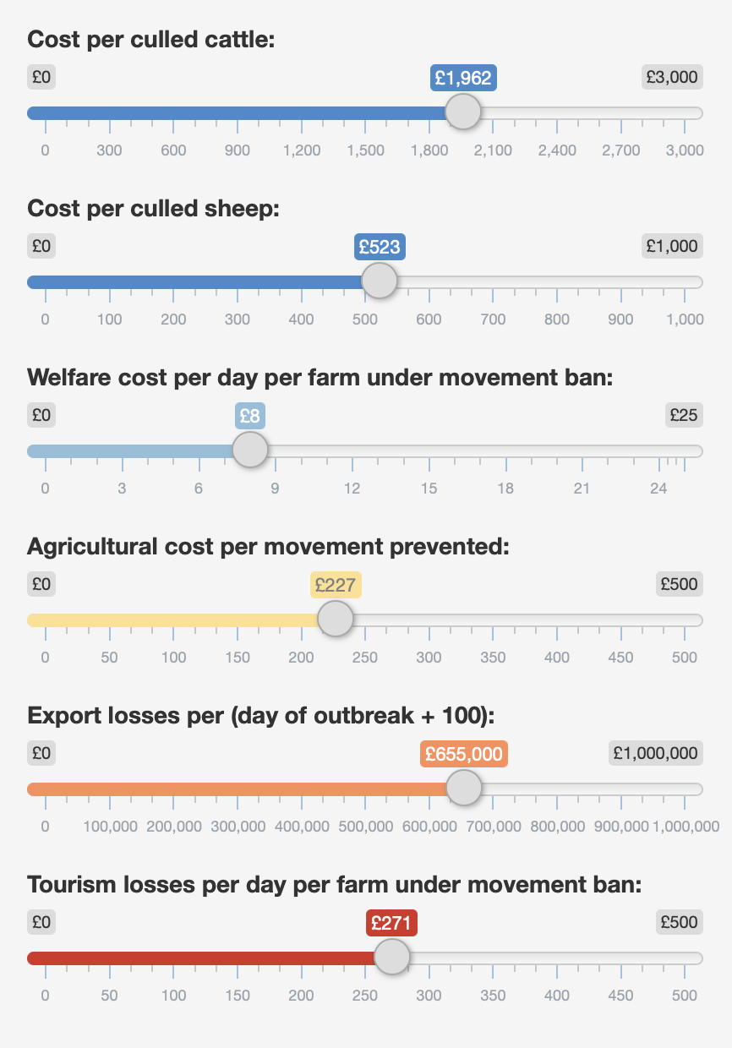
Notes:
2 types of plots

Slide 10
Recalculate mean costs
->
Update plot 1 output
Cattle slider
Sheep slider
Welfare slider
How can this be optimised?
Agricultural slider
Recalculate mean costs
->
Update plot 2 output
Export slider
Tourism slider

Slide 11
Cattle slider
Update plot 1 output
Sheep slider
Reactive expression
Welfare slider
Recalculate mean costs
Agricultural slider
Export slider
Update plot 2 output
Tourism slider

Slide 12
Reactive expressions
Allow Shiny to do less recomputing when inputs change
Make the app more efficient
Make the code easier to understand and maintain

Slide 13
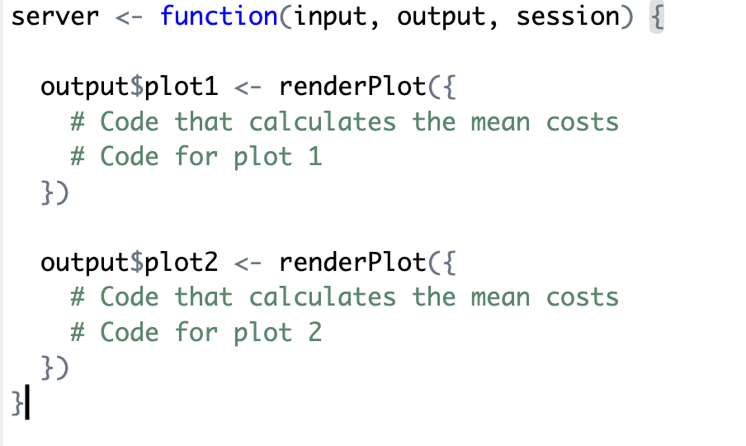

Slide 14
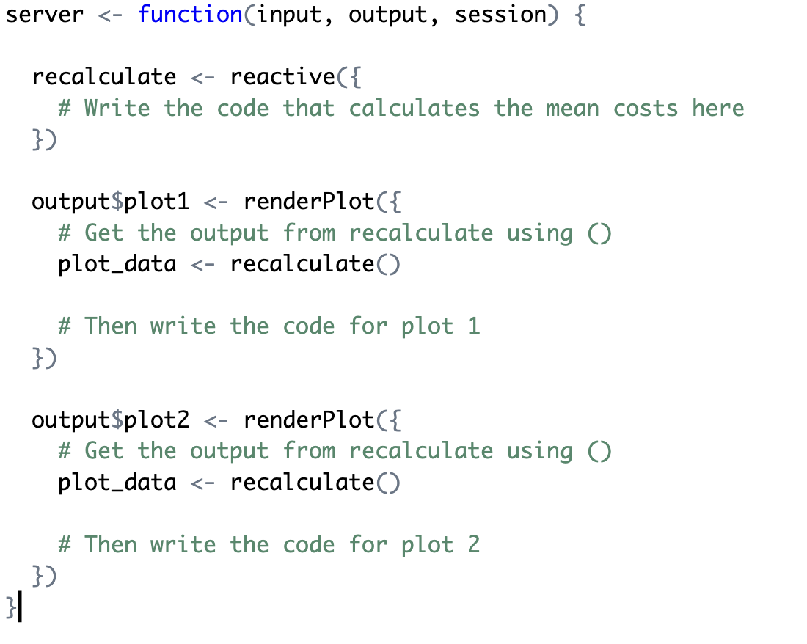

Slide 15
reactivity and data
Think about the format of your data
Is there any element that is always carried out?
You want to ‘pre-process’ the data as much as possible to minimise the amount of computation that needs to be done within Shiny
Reactivity should be linked with elements of data that depend on the inputs
Not always an easy decision but it is important to think about this first before writing your code

Slide 16

What if my app using complex calculations?
Notes:
Simple app

Slide 17
Change value of an input slider
Recalculate mean costs (fast arithmetic)
Update plot output

Slide 18

Run a statistical model (slow, computationally expensive)
Change value of an input slider
Update plot output
Change value of an input slider
Change value of an input slider

Slide 19
Action buttons
You can use an action button to allow the user to delay reactivity
There are other uses for action buttons - see https://shiny.posit.co/r/articles/build/action-buttons/

Slide 20
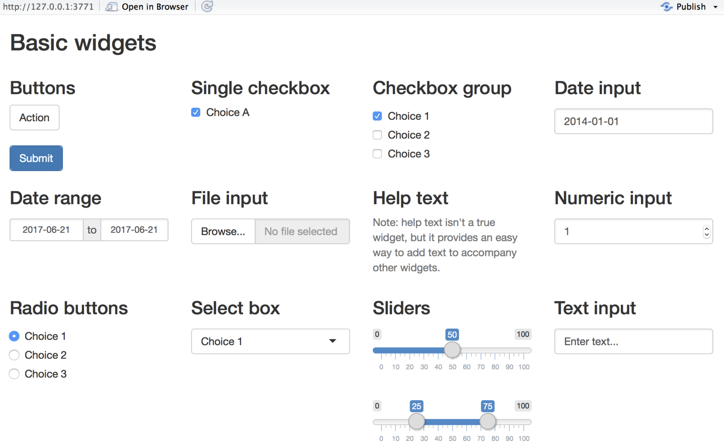

Slide 21

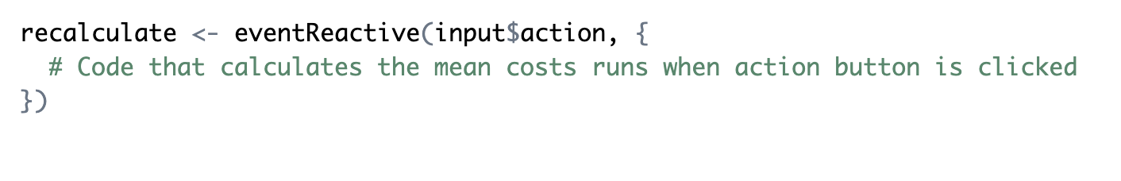
UI
server

Slide 22
Run a statistical model (slow, computationally expensive)
Change value of an input slider
Update plot output
Run

Slide 23
Now try the reactivity problems in Part 2 of the material – reactivity.Rmd
https://github.com/nabury/shiny-masterclass
For more detail on reactivity in Shiny see Chapter 3 of Mastering Shiny
https://mastering-shiny.org/basic-reactivity

